Slide 1

Mechatronics Group Project
Group 1044-PC2-12
—— Uchenna Obikwelu
Nikolas Sante
Shenhao Gong

Slide 2
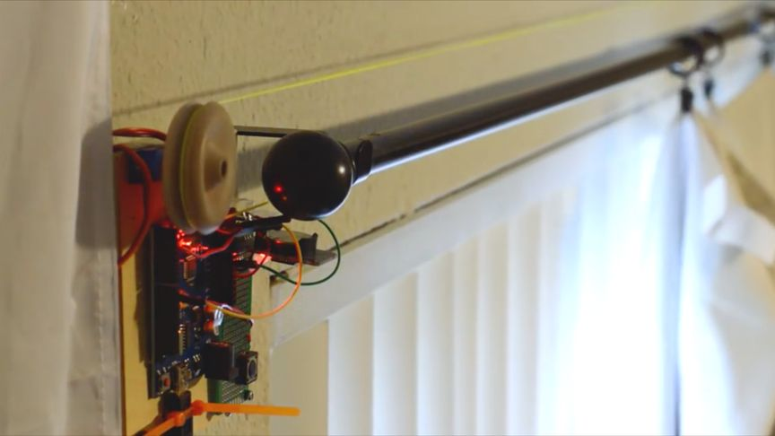
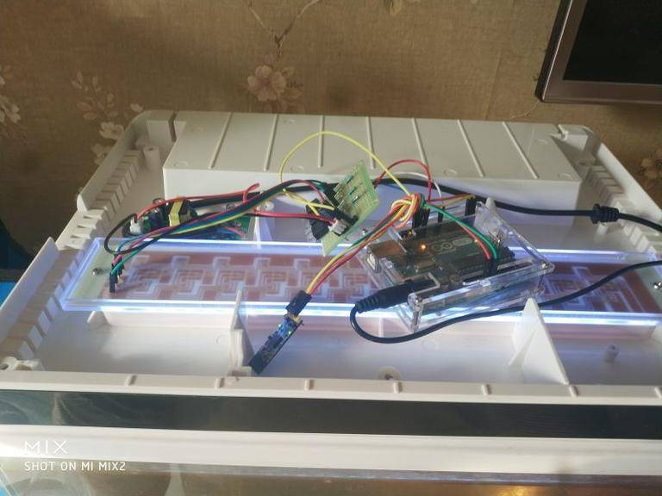
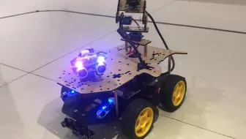
Initial Raspberry Pi Project Ideas
Shenhao Gong :
1. Automatic window shades 2.Shared Fish Tank Camera 3. Remote control toy car-signal receiver
Notes:
We first split off and tried coming up with potential ideas for projects we could do. This required minimal research on our part and we all chose projects that would be interesting to us. Some ideas were more practical than others but ultimately was not a concern in choosing. This was our brainstorm session and took us multiple days to finalise our list. We had a wide range, from fun ideas to very useful ideas, all while implementing the Raspberry Pi.

Slide 3
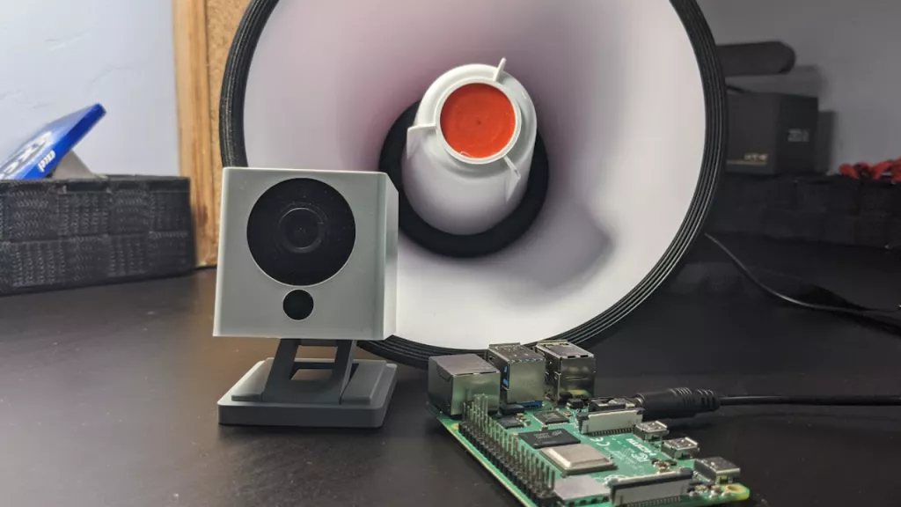
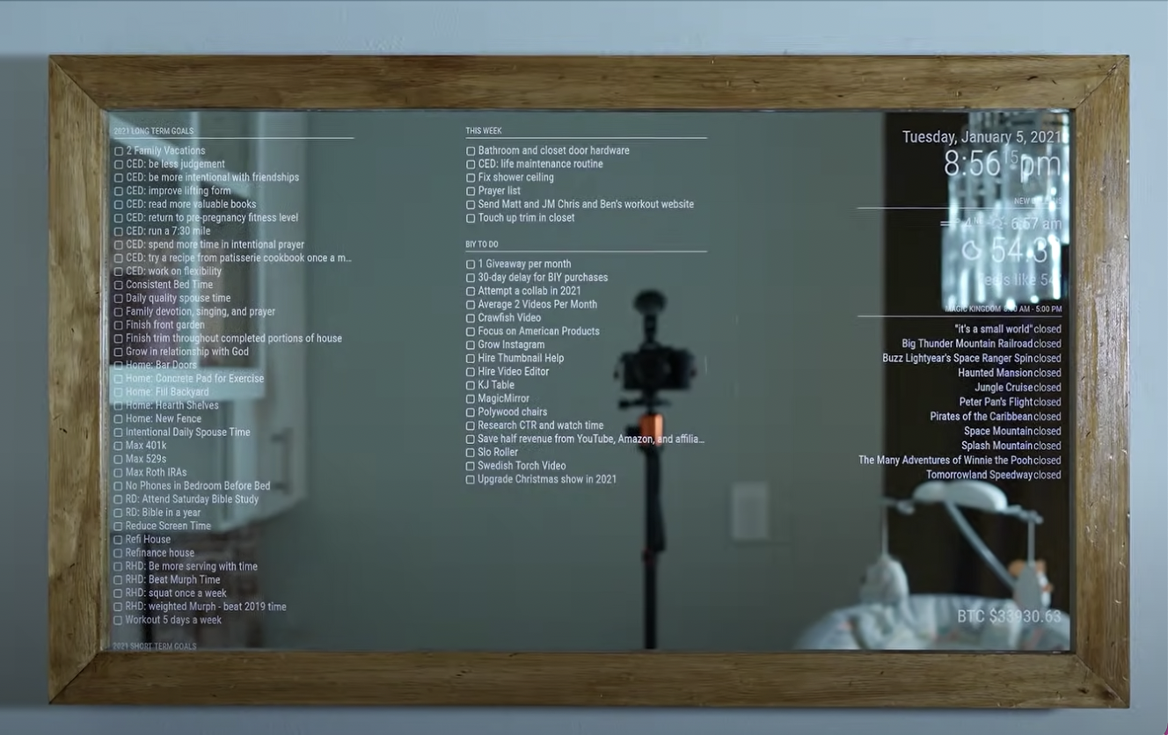
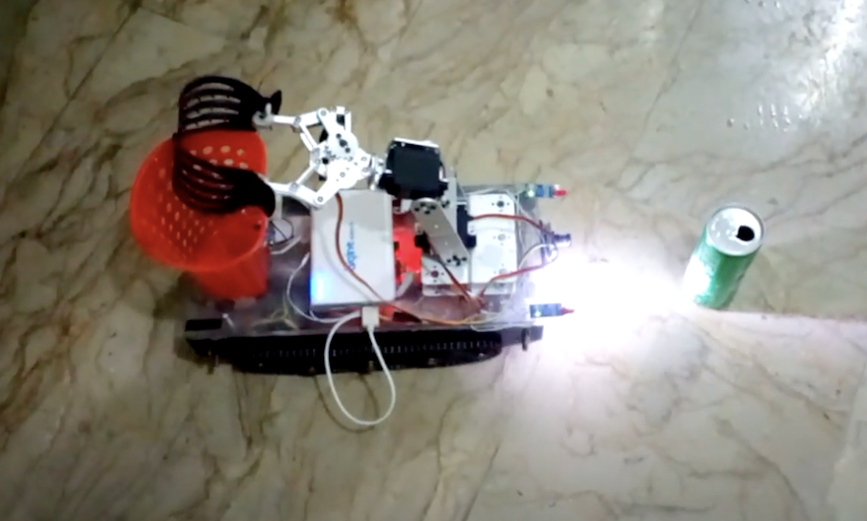
Initial Raspberry Pi Project Ideas
Uchenna Obikwelu:
1.Person-Detecting Doorbell 2.Smart Mirror 3.Garbage Thrasher

Slide 4
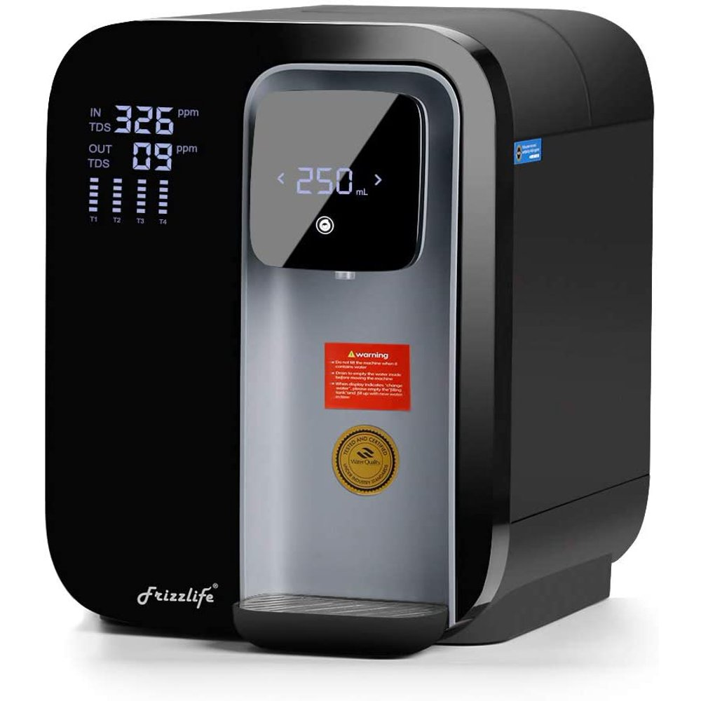
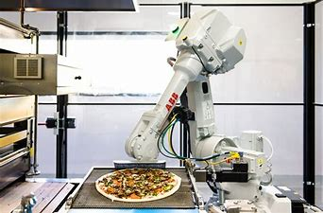
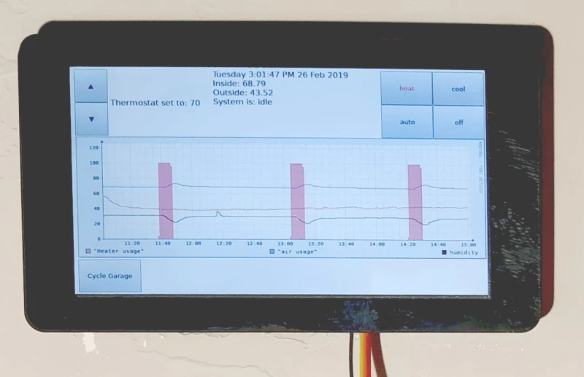
Initial Raspberry Pi Project Ideas
Nikolas Sante:
1.Baker/chef 2. Water quality testing and self-filter 3. Automatic cooler/heater / AC unit / thermostat

Slide 5
Discussion of ideas
From the point of view of applicability, interest and feasibility,The following projects are selected to do further research:
-Shared Fish Tank,
-Person-Detecting Doorbell
-Automatic cooler/heater / AC unit / thermostat

Slide 6
Best ideas and research
Winner:
Automatic cooler/heater / AC unit / thermostat
🎉🎉🎉
Notes:
We finally chose Automatic cooler/heater controler as our best idea because of its wide audience, high feasibility, manageable cost and short testing period.

Slide 7
Why?
-Huge user base
-High feasibility
-manageable cost
-short test period

Slide 8
Weighted trade study
 | Doorbell | AC | Fish Tank
Societal Impact/practicality (20%) | 10/10 9/10 | 10/10 10/10 | 3/10 6/10
Cost (30%) | 7/10 6/10 | 8/10 7/10 | 7/10 8/10
Feasibility (30%) | 8/10 7/10 | 8/10 8/10 | 8/10 8/10
Simplicity (10%) | 10/10 8/10 | 7/10 7/10 | 10/10 10/10
Safety (10%) | 10/10 10/10 | 9/10 10/10 | 9/10 10/10
Scores | 8/10 | 8.3/10 | 7.5/10
5 criteria for weighted trade study:
Societal Impact/Practicality (20%)
Cost (30%)
Feasibility/ Ability to Create (30%)
Safety (10%)
Simplicity (10%)
Selected project idea :
Automatic AC/Thermostat
Notes:
We decided on 5 criteria for our weighted trade study, including the two pre-determined criteria cost and societal impact. They were the following: Societal impact/practicality, at a weight of 20% since they were important but not our biggest factor, Cost at 30% since we greatly considered having less expensive project ideas, Feasibility/ability to create at 30% since it was the other big consideration for our decisions, Safety at 10% since we didn’t consider it very much during the process, and Simplicity at 10% although we did consider it it wasn’t very important for the ideas to be simple. Following the trade study where we gave our honest judgement of each other’s projects, we ended up with the Automatic AC as our main project. The other projects however were very close in score.

Slide 9
Conclusion
Project length - approximately 2 weeks
Brainstorm and research took the most time
Lessons learned:
stay on schedule
assign tasks early and clearly
keep each other accountable
Notes:
Our project took around two weeks to complete from start to finish, and we encountered many potential project ideas to research. Brainstorming ideas took a large portion of our first week, while researching our selected ‘best’ ideas took most of our time in the second week. Being able to compare our ideas gave each of us an insight into wha each of us thought were good project ideas, and allowed for interesting discussion. While we might’ve liked to choose a different project as ‘best’, our chosen projects were overall the best. One lesson we learned from this project is the importance of staying on a schedule and allocating time and tasks in order to stay on schedule. This is by far the easiest way of working on a project and keeping each other accountable.

